Slide 1
CiviCRM Entity - Superior Drupal Integration
A parallel, inclusive vision for the future.
A working use case of headless CiviCRM

Slide 2
What is CiviCRM Entity?
Drupal module that integrates nearly 30 CiviCRM entities including:
Contacts
Addresses
Emails
Phones
Notes
Activities
Events
Contributions
Participants
Price Sets
It’s not just a tool, it’s the electric cable that powers the tool

Slide 3
What is CiviCRM Entity?
A Drupal module that makes Drupal think CiviCRM data IS Drupal data
Opens up CiviCRM to functionality and customization using 100s of Drupal modules via Drupal Core and Drupal Entity API
Wraps CiviCRM API Entities calls in extended Drupal Entity controllers.
CiviCRM Wi-fi for your Drupal website

Slide 4
Why CiviCRM Entity?
Drupal People Want To Use Drupal Modules!
Attempted forks of CiviCRM to pure Drupal have failed, don’t leave it, use it differently.
The idea is to use CiviCRM as a library and provide COMPLETE DRUPAL INTEGRATION.
‘Headless CiviCRM’ with focus on integration modules.
A parallel, inclusive vision for the future.

Slide 5
Why CiviCRM Entity?
One website, One system
Consistent and familiar interface
Attractive to Drupal developers
Build interfaces for alternative CRM use cases
Don’t wait for CiviCRM to have a feature, Drupal may already have it
Because CRM is not just needed by non-profits organizations

Slide 6
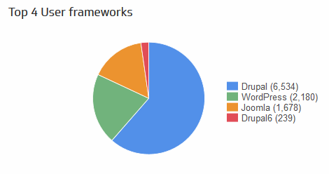
Why CiviCRM Entity?
Because Most People Use CiviCRM With Drupal Anyway
Fully ⅔ of CiviCRM Installations are integrated with Drupal 7
That’s called a super majority.
https://stats.civicrm.org/?tab=sites

Slide 7
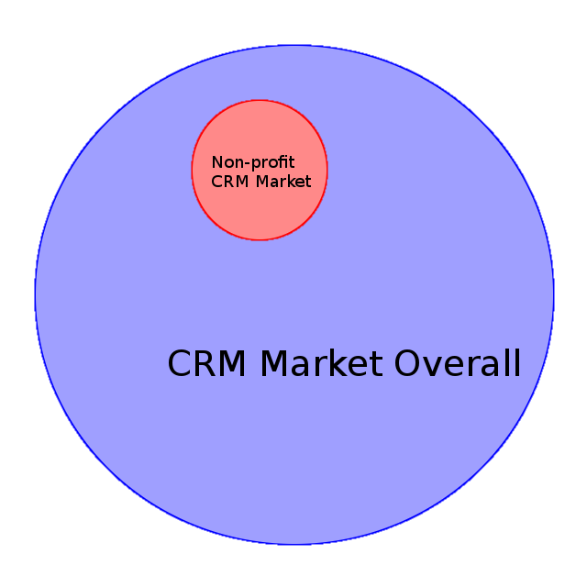
Why CiviCRM Entity?
Use CiviCRM in new and different ways

Slide 8
Why CiviCRM Entity?
If you integrate with Drupal, CiviCRM is the BEST.
Codified business logic coming from years of CRM community interaction
High quality PHP, Javascript, and REST API
Normalized Database Structure
Because CiviCRM is the BEST OPEN SOURCE CRM

Slide 9
CiviCRM Entity -- Who is it for?
Drupal Developers
Drupal Site builders
Drupal Implementers
Drupal Content Creators
Drupal Savvy Anybody

Slide 10
Uses for Content Creators
Blend CiviCRM data with Drupal data
Allow content creators to use CiviCRM data in other Drupal content or entities, without giving them access to CiviCRM Back end
Integrate with complex authoring and revisioning workflows
One Website, One Interface
Content Creators need only know Drupal
https://skvare.com/blog/civicrm-entity-and-inline-entity-form

Slide 11
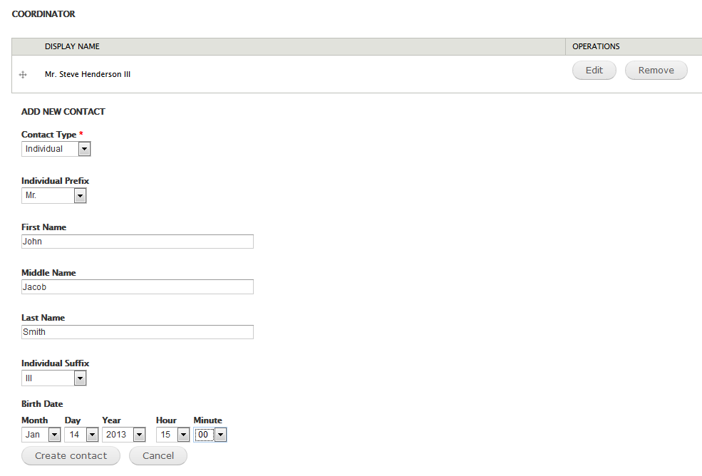
Notes:
jgjbhbhjkhbkjb

Slide 12
Uses for Site Builders
Any Drupal module that makes use of Drupal entities, can make use of CiviCRM data.
Add Drupal Fields to CiviCRM data
Field group
Views & co.
Rules & co.
Entity Reference & co.
Display Suite
Search API
Facet API
Voting API / Fivestar
Entity Views Attachments
OpenLayers Maps
Leaflet Maps
Reply -- for comments on entities
Views Bulk Operations
Entityqueue
Flag
More but I’m out of space….

Slide 13
Uses for Site Builders
Drupal Fields!
Add any Drupal field type
Use any Drupal field formatters (for Drupal Fields)
Customizable layout with Display Suite both for viewing and editing
Field groups
You may never see another CiviCRM Custom Field Type...Don’t wait, you can have it now!
Responsive Images
Slideshows
Videos
Audio
Etc…..
There are many available Drupal field types in contributed modules

Slide 14
Custom fields Vs. Drupal Fields
CiviCRM Custom Fields vs. Drupal fields Rule of Thumb
If it has to do with Presentation, do it with Drupal fields.
If it has to do with long term data storage, do it with CiviCRM Custom Fields (and then only maybe)
@Skvare we use CiviCRM custom fields if
Technically we have to for some reason
The client specifically wants it there
The client has to have it in a CiviCRM Custom Report
Which doesn’t happen very often because we use Views for Reports.
Export data from Views with Views Data Export module

Slide 15
Drupal Fields on CiviCRM Contact pages
So you have some Drupal fields on your CiviCRM Contacts and you want to show that data in the CiviCRM backend
Put them on the Contact Summary Page as a Tab or a Fieldset
Bonus: Any Views content can go in the Contact Summary Page
Open/create your view listing CiviCRM Contacts and add a new “CiviCRM Contact Page” display
Add a Contact ID Contextual Filter
Add Drupal fields at will and save (Make sure to set all of the page settings!)
Activity Status
Region(Summary Pane or Tab)
Weight
https://www.drupal.org/project/civicrm_views_contact_page

Slide 16
Workshop -- Entity Reference
Reference CiviCRM Data from any other Drupal Entity
Display a specific View Mode of that data along with the Node/Entity data
Rules Chaining
Views Relationships
https://www.drupal.org/project/entityreference

Slide 17
Workshop -- Drupal View Pages
Drupal View pages for CiviCRM Data
Recommend installing Display Suite
https://www.drupal.org/project/ds
Create Multiple View Modes
Arrange fields as you like
Display Suite Custom Fields !!!
Use Rendered View Modes in Views or EntityReference field displays
Example:
<your_site>/civicrm-contact/1

Slide 18
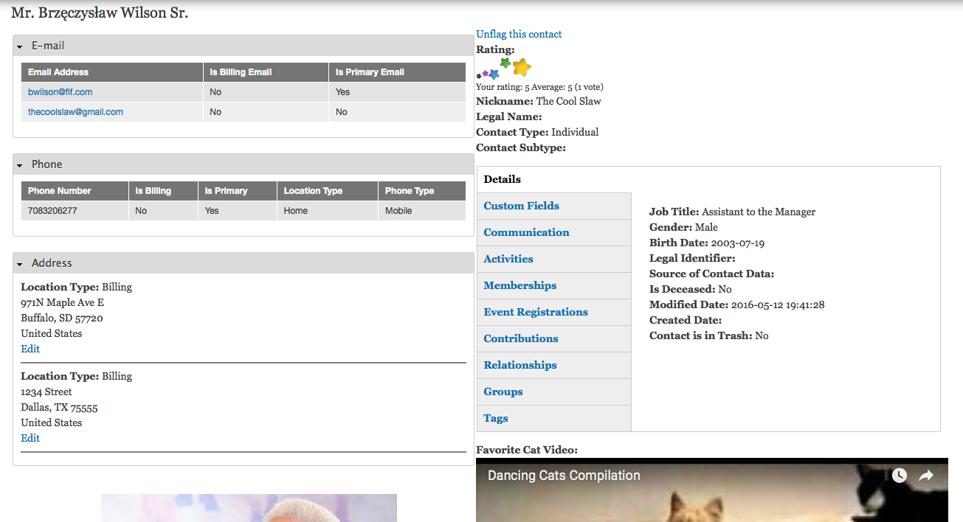
Notes:
jgjbhbhjkhbkjb

Slide 19
Workshop -- Drupal Edit Pages
We got your form builder right here
Drupal add/edit pages for CiviCRM Data
Recommend installing Display Suite Forms
A sub-module of Display Suite
Arrange custom edit forms with field groups
Example:
<your_site>/civicrm-contact/1/edit

Slide 20
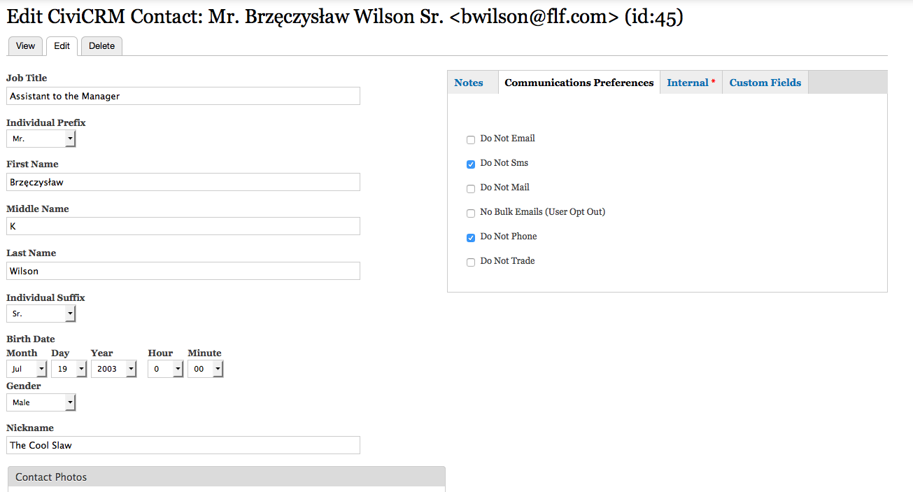
Notes:
jgjbhbhjkhbkjb

Slide 21
CiviCRM Entity for Developers
Entity API, CRUD operations
Full Entity Metadata Wrappers
Drupal theming practices, preprocess and templates
Customize your site without knowing a single bit of CiviCRM API
Build your own custom, responsive forms for specific use cases
Drupal Developers like to use the Drupal API and standards

Slide 22
Drupal Core API
entity_load()
Standard Drupal entity hooks
hook_entity_load()
hook_entity_view()
hook_entity_update
hook_entity_insert()
hook_entity_presave()
hook_entity_delete()
hook_form_alter()
mymodule_entity_presave($entity, $type) {
// if its a contact
if($type == 'civicrm_contact'){
// do something
}
}
…..
$contact = entity_load(‘civicrm_contact’, array(45));
$name = $contact->display_name;

Slide 23
Drupal Entity API
https://www.drupal.org/project/entity
entity_load_single()
entity_save()
entity_metadata_wrapper()
https://www.drupal.org/documentation/entity-metadata-wrappers
We have access to a fully OOP API RIGHT NOW!!
$contact = entity_load_single('civicrm_contact', 45);
$contact_wrapper = entity_metadata_wrapper('civicrm_contact', $contact);
$name = $contact_wrapper->first_name->value();
$name = $name . ' The Dude';
$contact_wrapper->first_name->set($name);
$contact_wrapper->save();
Get metadata
$info = $contact_wrapper->first_name->info();

Slide 24
Integrate additional CiviCRM Entities
CiviCRM Entity 7.x-beta2 provides:
hook_civicrm_entity_supported_info().
Works in CiviCRM Extensions or Drupal modules
Permissions default to ‘administer CiviCRM’
See civicrm_entity.api.php
State/Province API Entity
County API Entity provided by custom extension
function countyapi_civicrm_entity_supported_info(&$entity_info) {
$entity_info['civicrm_county'] = array(
'civicrm entity name' => 'county',
'label property' => 'name',
);
$entity_info['civicrm_state_province'] = array(
'civicrm entity name' => 'stateprovince',
'label property' => 'name',
);
}

Slide 25
Alter the Drupal Entity Integration
Acts as typical _alter() hook as well
Drupal View/Edit/Create/Delete Form permissions
Use one or more Drupal permission machine names
function mymodule_civicrm_entity_supported_info(&$civicrm_entity_info) {
$civicrm_entity_info['civicrm_phone'] = array(
'permissions' => array(
'view' => array(‘my custom permission’),
'edit' => array('edit all contacts', ‘my custom permission’),
'update' => array('edit all contacts', ‘my custom permission’),
'create' => array('edit all contacts', ‘my custom permission’),
'delete' => array('delete contacts', ‘my custom permission’),
),
);
}

Slide 26
Alter the Drupal Entity Integration
Theme Template Settings
‘template’ => name of file without the .tpl.php
‘path’ => path to location of template file
function mymodule_civicrm_entity_supported_info(&$civicrm_entity_info) {
$civicrm_entity_info['civicrm_phone'] = array(
'theme' => array(
'template' => 'civicrm-phone',
'path' => drupal_get_path('module', 'mymodule') . '/templates'
),
);
}

Slide 27
Alter the Drupal Entity Integration
Display Suite Formatters
Alter output of entity properties
Output as links
Output Option Values
Output Booleans as Yes/No, True/False
function mymodule_civicrm_entity_supported_info(&$civicrm_entity_info) {
$civicrm_entity_info['civicrm_phone'] = array(
'display suite' => array(
'link fields' => array(
array(
'link_field' => 'contact_id',
'target' => 'civicrm_contact',
),
),
'option fields' => array(
'location_type_id',
'mobile_provider_id',
'phone_type_id'),
'boolean fields' => array('is_primary', 'is_billing',),
),
);
}

Slide 28
function mymodule_civicrm_entity_supported_info(&$civicrm_entity_info) {
$civicrm_entity_info['civicrm_phone'] = array(
'civicrm entity name' => 'phone',
'label property' => 'phone',
'permissions' => array(
'view' => array('my custom permission'),
'edit' => array('edit all contacts', 'my custom permission'),
'update' => array('edit all contacts', 'my custom permission'),
'create' => array('edit all contacts', 'my custom permission'),
'delete' => array('delete contacts', 'my custom permission'),
),
'theme' => array(
'template' => 'civicrm-phone',
'path' => drupal_get_path('module', 'mymodule') . '/templates'
),
'display suite' => array(
'link fields' => array(
array(
'link_field' => 'contact_id',
'target' => 'civicrm_contact',
),
),
'option fields' => array('location_type_id', 'mobile_provider_id', 'phone_type_id'),
'boolean fields' => array('is_primary', 'is_billing',),
),
);
}

Slide 29
Developers are already using it….
CiviCRM Entity Address Extra -- extra address tokens
CiviCRM Entities Flexiform -- another way to make customizable forms
CiviCRM Entity Inline -- integrates with Inline Entity Form
CiviCRM Price Field Aux - Good example of extended Views integration, Views relationships for Price Sets, Price Fields, Price Field Values for Events and Contributions
It’s not just a tool, it’s the electric cable that powers the tool

Slide 30
Development Plans
Short Term:
Foolproof form validation
Improved “Psuedo reference” field handling
Mid Term:
Entity-ize Profiles and be able to view, add, edit profiles and fields on profiles
Long Term:
Contribution and Event registration view pages that fetch price set info and run the transactions
Drupal 8 version -- more important now that Webform is unlikely to be ported.
Backdrop version

Slide 31
Development Plans
The reality of Drupal 8 integration without Webform CiviCRM
Exposure of Profiles as Entities and Rules reactions
The improved Contact Form?
Consider Drupal Commerce Integration

Slide 32
https://drupal.org/project/civicrm_entity
https://drupal.org/project/webform_civicrm
https://github.com/jackrabbithanna/civicrm_entity_inline
https://github.com/jackrabbithanna/civicrm_price_field_aux
https://www.drupal.org/project/civicrm_entities_flexiform
https://www.drupal.org/project/civicrm_entity_address_extra
Notes:
jgjbhbhjkhbkjb

Slide 33
I have so much more I could talk about and teach.
Consider my presence a non-stop Drupal/CiviCRM Integration BOF before, during, and after each day of conference
Ask me a question, let me help solve your problem
If I can’t figure it out or at least provide a plan of action in 30 minutes, I’ll eat my hat.
Mark Hanna
mark@skvare.com

